Slide 1

Welcome to Year 4
To be the best that we can be

Slide 2
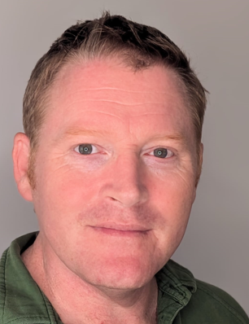
Meet your teacher!
About me
I have been teaching for almost twenty years
I have taught across Keys Stages 1 and 2, at a broad spectrum of different schools
My Roles within school:
Behaviour Lead Mental Health Lead DT Lead
DDSL (Safeguarding Team)
Senior Leadership Team
Mr Johnston
Contact Information
johnston.m1@welearn365.com
01789 267015
Class Dojo

Slide 3
School Values
To be the best that we can be
Respect
Empathy
Responsibility
Teamwork
Resilience
Kindness and Caring

Slide 4
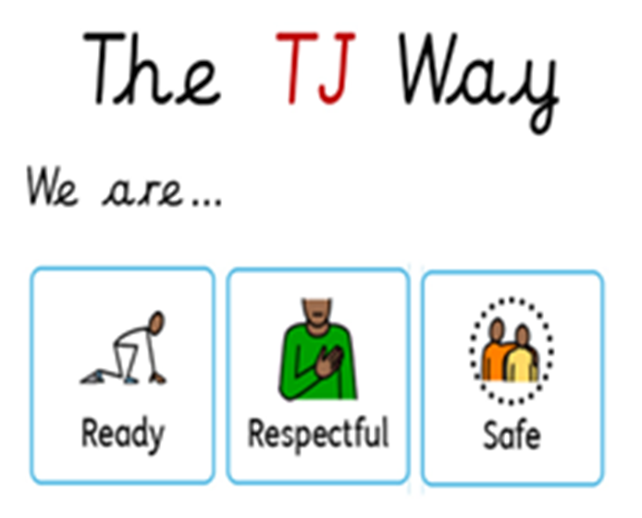
School Values
To be the best that we can be

Slide 5
Expectations for all
Punctuality
Communication
Correct school uniform
Long hair tied up
P.E. Kit
Limited jewellery- watch and 1 pair of earrings
No mobile phones
Daily equipment
e.g. water bottle

Slide 6
A typical day in Year 4
Wider Curriculum
Geography
History
Science
Art and D.T
P.S.H.E- Protective behaviours, jigsaw, ZOR, No outsiders
French
R.E
P.E
Music
Daily
Early Morning Work
Maths
English
Teaching of Reading
Free reading
Theme
Class reading Time
Extras
Assembly
GPS and Spelling lessons
Swimming (after Christmas
Outdoor Learning
Well-being lesson
No Outsiders (half termly)

Slide 7
Homework
Reading at least 4 times a week and signed in reading records
Weekly spelling activity (spelling shed and written activity) set on a
Friday and returned on the following Friday.
GPS and Math set every Friday. To be handed in the following Friday.
Theme to be set termly. Activities linked to Foundation Curriculum.

Slide 8
Homework Expectations
Homework to be handed in on time.
Children’s work. Support can be given. Please encourage your child to speak to their class teacher if they are finding it difficult.
To be completed to a high standard- cursive handwriting in a blue/black pen or pencil.
Homework completed in homework books (in school weekly).

Slide 9
Key Dates/ Upcoming Events
Autumn Term – potential trip to a Shakespeare property
December- Christmas Singalong
Summer Term – trip to Cadbury World
Multiplication Tables Check (MTC) – all children will take a short multiplication test set by the Government

Slide 10
Thank you!
Do you have any questions?
admin2052@welearn365.com
price.c2@welearn365.com
johnston.m1@welearn365.com

