Slide 1

Phonics Screening Check Information session for parents and carers 2026
Thank you for coming ☺

Slide 2

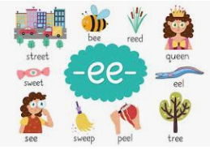
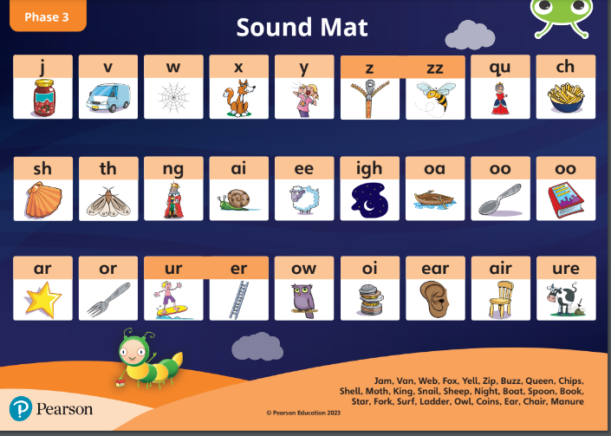


Recap of Phonics
Words are made up from small units of sound called phonemes.
Learning these phonemes helps children to learn to read words and to spell words.
In phonics lessons children are taught three main things:
GPCs (Grapheme, phoneme correspondence)
Blending
Segmenting

Slide 3
GPC
Grapheme phoneme correspondences
This stands for grapheme phoneme correspondences. This simply means that they are taught all the phonemes (sounds) in the English language and ways of writing them down. These sounds are taught in a particular order. The first sounds to be taught are s, a, t, p, i, n. They then learn digraphs (2 letters making one sound), such as ee, ea, ey , trigraphs (3 letters making one soung), like igh and ear, split digraphs, such as e_e and a_e, quadraphs, like eigh.

Slide 4



Blending
This is when children say the sounds that make up a word and are able to merge the sounds together until they can hear what the word is.
c-a-t = cat
f-ee-t = feet
e-l-e-ph-a-n-t = elephant

Slide 5
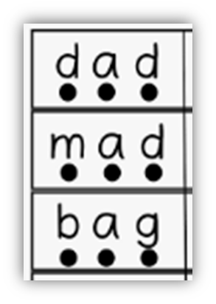
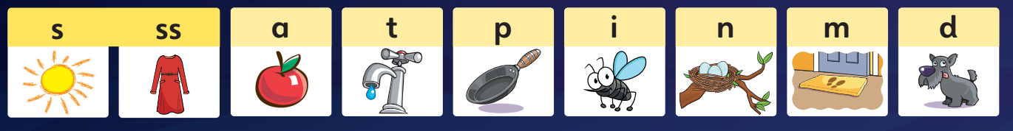
Segmenting
Pure sounds
The pronunciation of each letter sound clearly and distinctly without adding additional sounds to the end.
‘f’ not ‘fuh’
This is the opposite of blending. Children are able to say a word and then break it up into the phonemes that make it up. This helps their spelling.
cat = c-a-t
feet = f-ee-t
elephant = e-l-e-ph-a-n-t

Slide 6
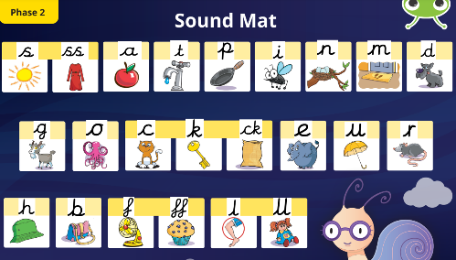
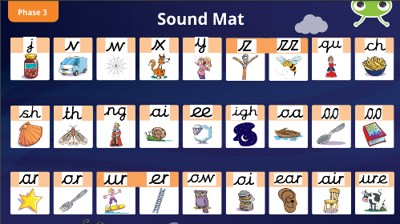
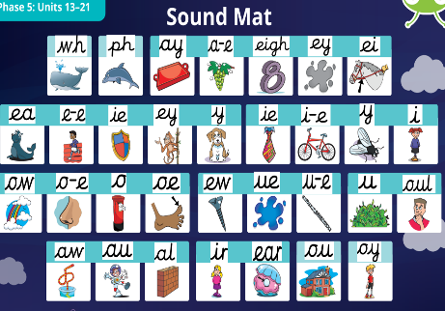
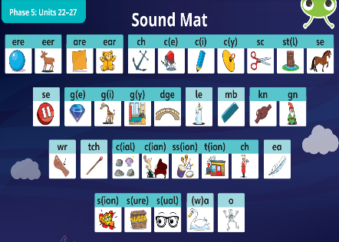
Phase 1: Nursery/preschool (no letters are introduced – environmental sounds/rhyme, alliteration etc)
Phase 2: Reception (most initial/alphabet sounds are introduced – focus on CVC words)
Phase 3: Reception/Year 1 (re-cap), rest of initial sounds plus digraphs/trigraphs – focus on cvc words)
Phase 4: Reception (HA) Year 1 (no new sounds are introduced, focuses on blends and CCVC, CVCC words – slug, left)
Phase 5: Year 1 (before screen) and year 2 (catch-up) – another set of phonemes taught and alternative spellings
Phase 6: Year 2 - spelling patterns and
‘best guess’ grapheme selection

Slide 7

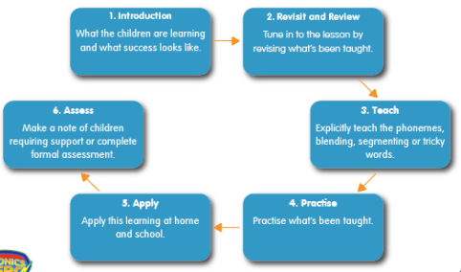
Bug Club Phonics
(TJ’s scheme)
We use Bug Club to teach phonics daily and the sounds we learn link to the reading books we send home.
Bug Club follows a clear order in which to teach the sounds and the lessons follow the same teaching sequence in every session.
As part of this we have access to online reading books and phonics games.

Slide 8


Year One and Two Phonics at TJ
Phonics happens every day and is the first lesson.
It is essential that your child is in school on time or they will miss it.
Children are in different groups for Phonics.
One group are with Miss Parry learning Phase 5 and a group are with Miss Fleming also learning Phase 5.
Some children are working with Mrs Mann recapping phase 3 and Mrs Carr and Mrs Beard are taking a phase 2/3 group.
Year two children who are secure in phonics have now moved on to whole class spelling lessons.
Please do not worry about the group your child is working in, all children will have covered up to the end of Phase 5 by the Phonics Screen in June.

Slide 9
Grouped Guided at TJ
Last year we were lucky enough to receive a bursary from the English Hub for phonics and Early Reading resources. This meant we were able to order lot’s of new Bug Club resources and books. This year we have set up group guided reading which has allowed us to listen to the children read more consistently in a purposeful groups. We are already seeing the impact that this has had on the children’s reading progression.
Children love these sessions and feel confident and excited to share their books with you at home
Children usually bring home 2 books each week. One they’ve read with us and one new book (on the same level focusing on the same sounds) .
Year 2 children who are not yet secure with their phonics, also have guided reading 4 times a week in small groups. Once they are secure they will move on to whole class reading each day

Slide 10
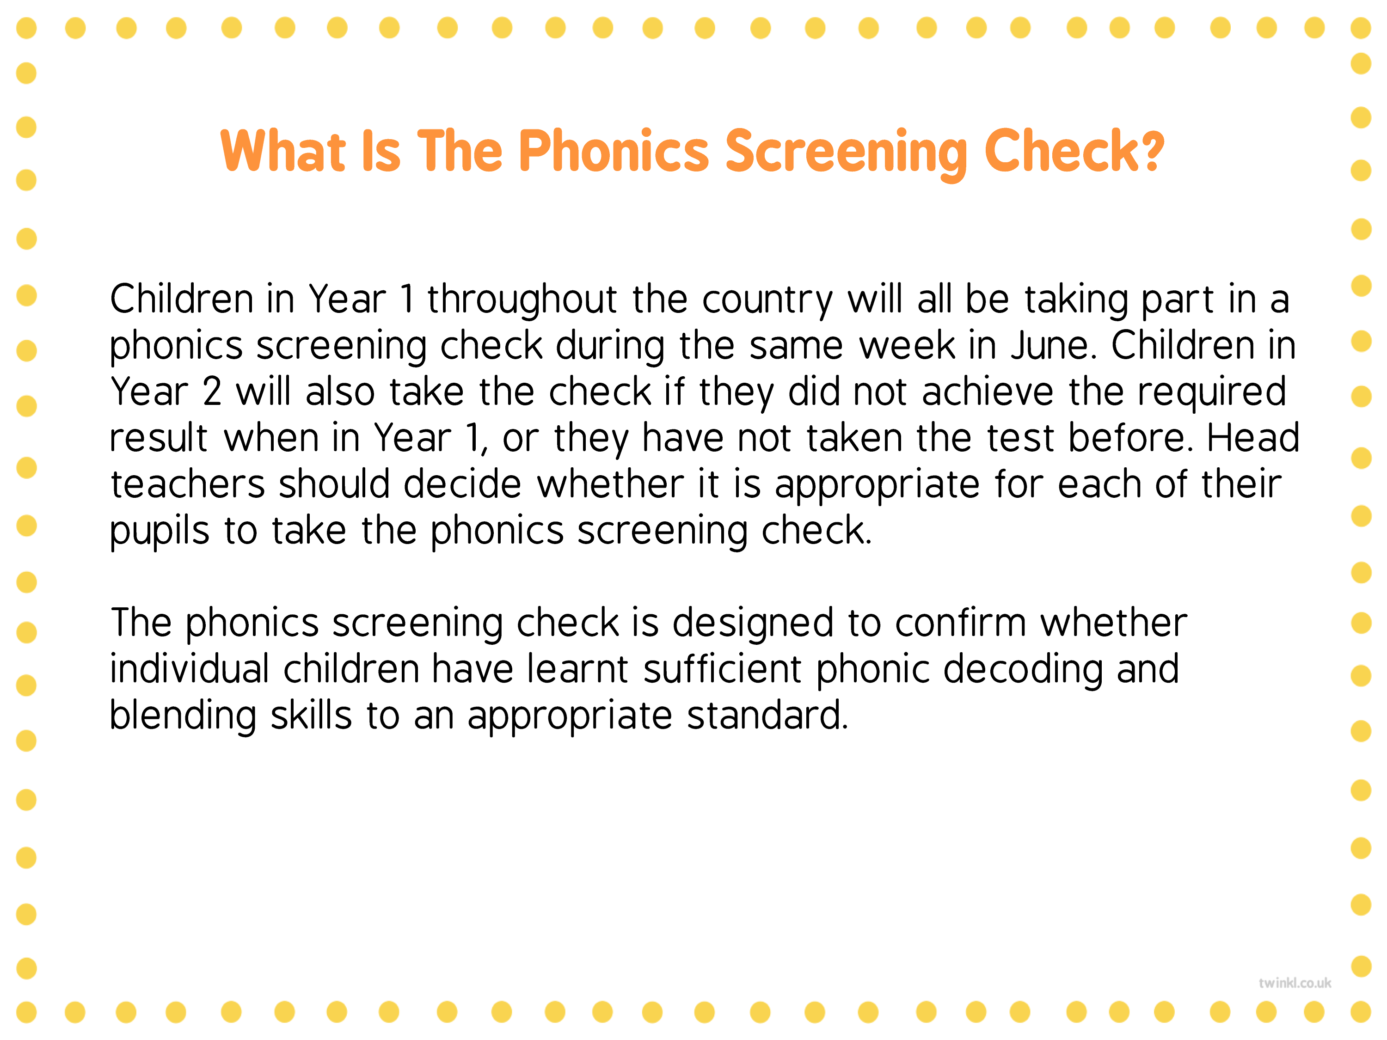
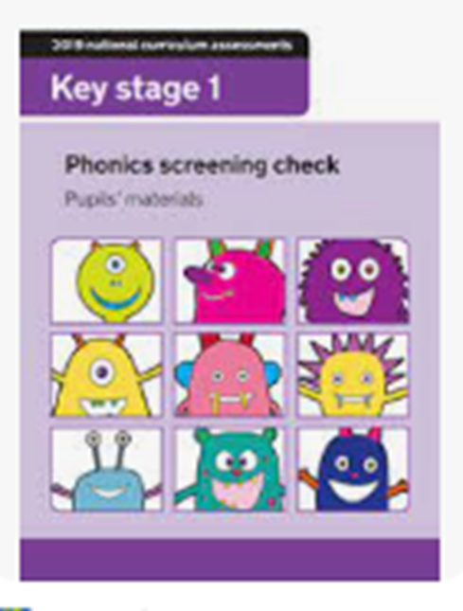
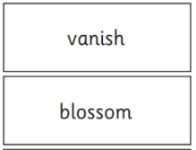
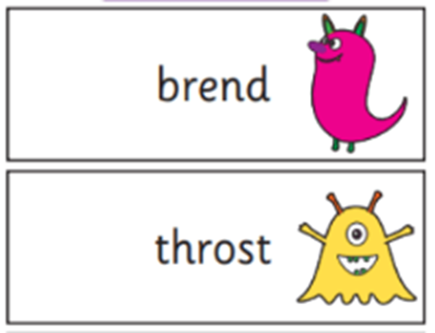

Slide 11
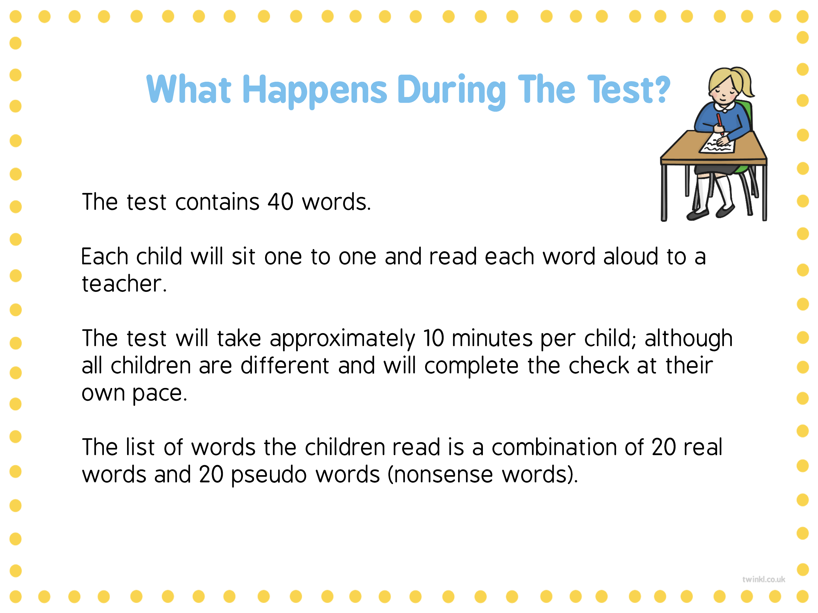

Slide 12
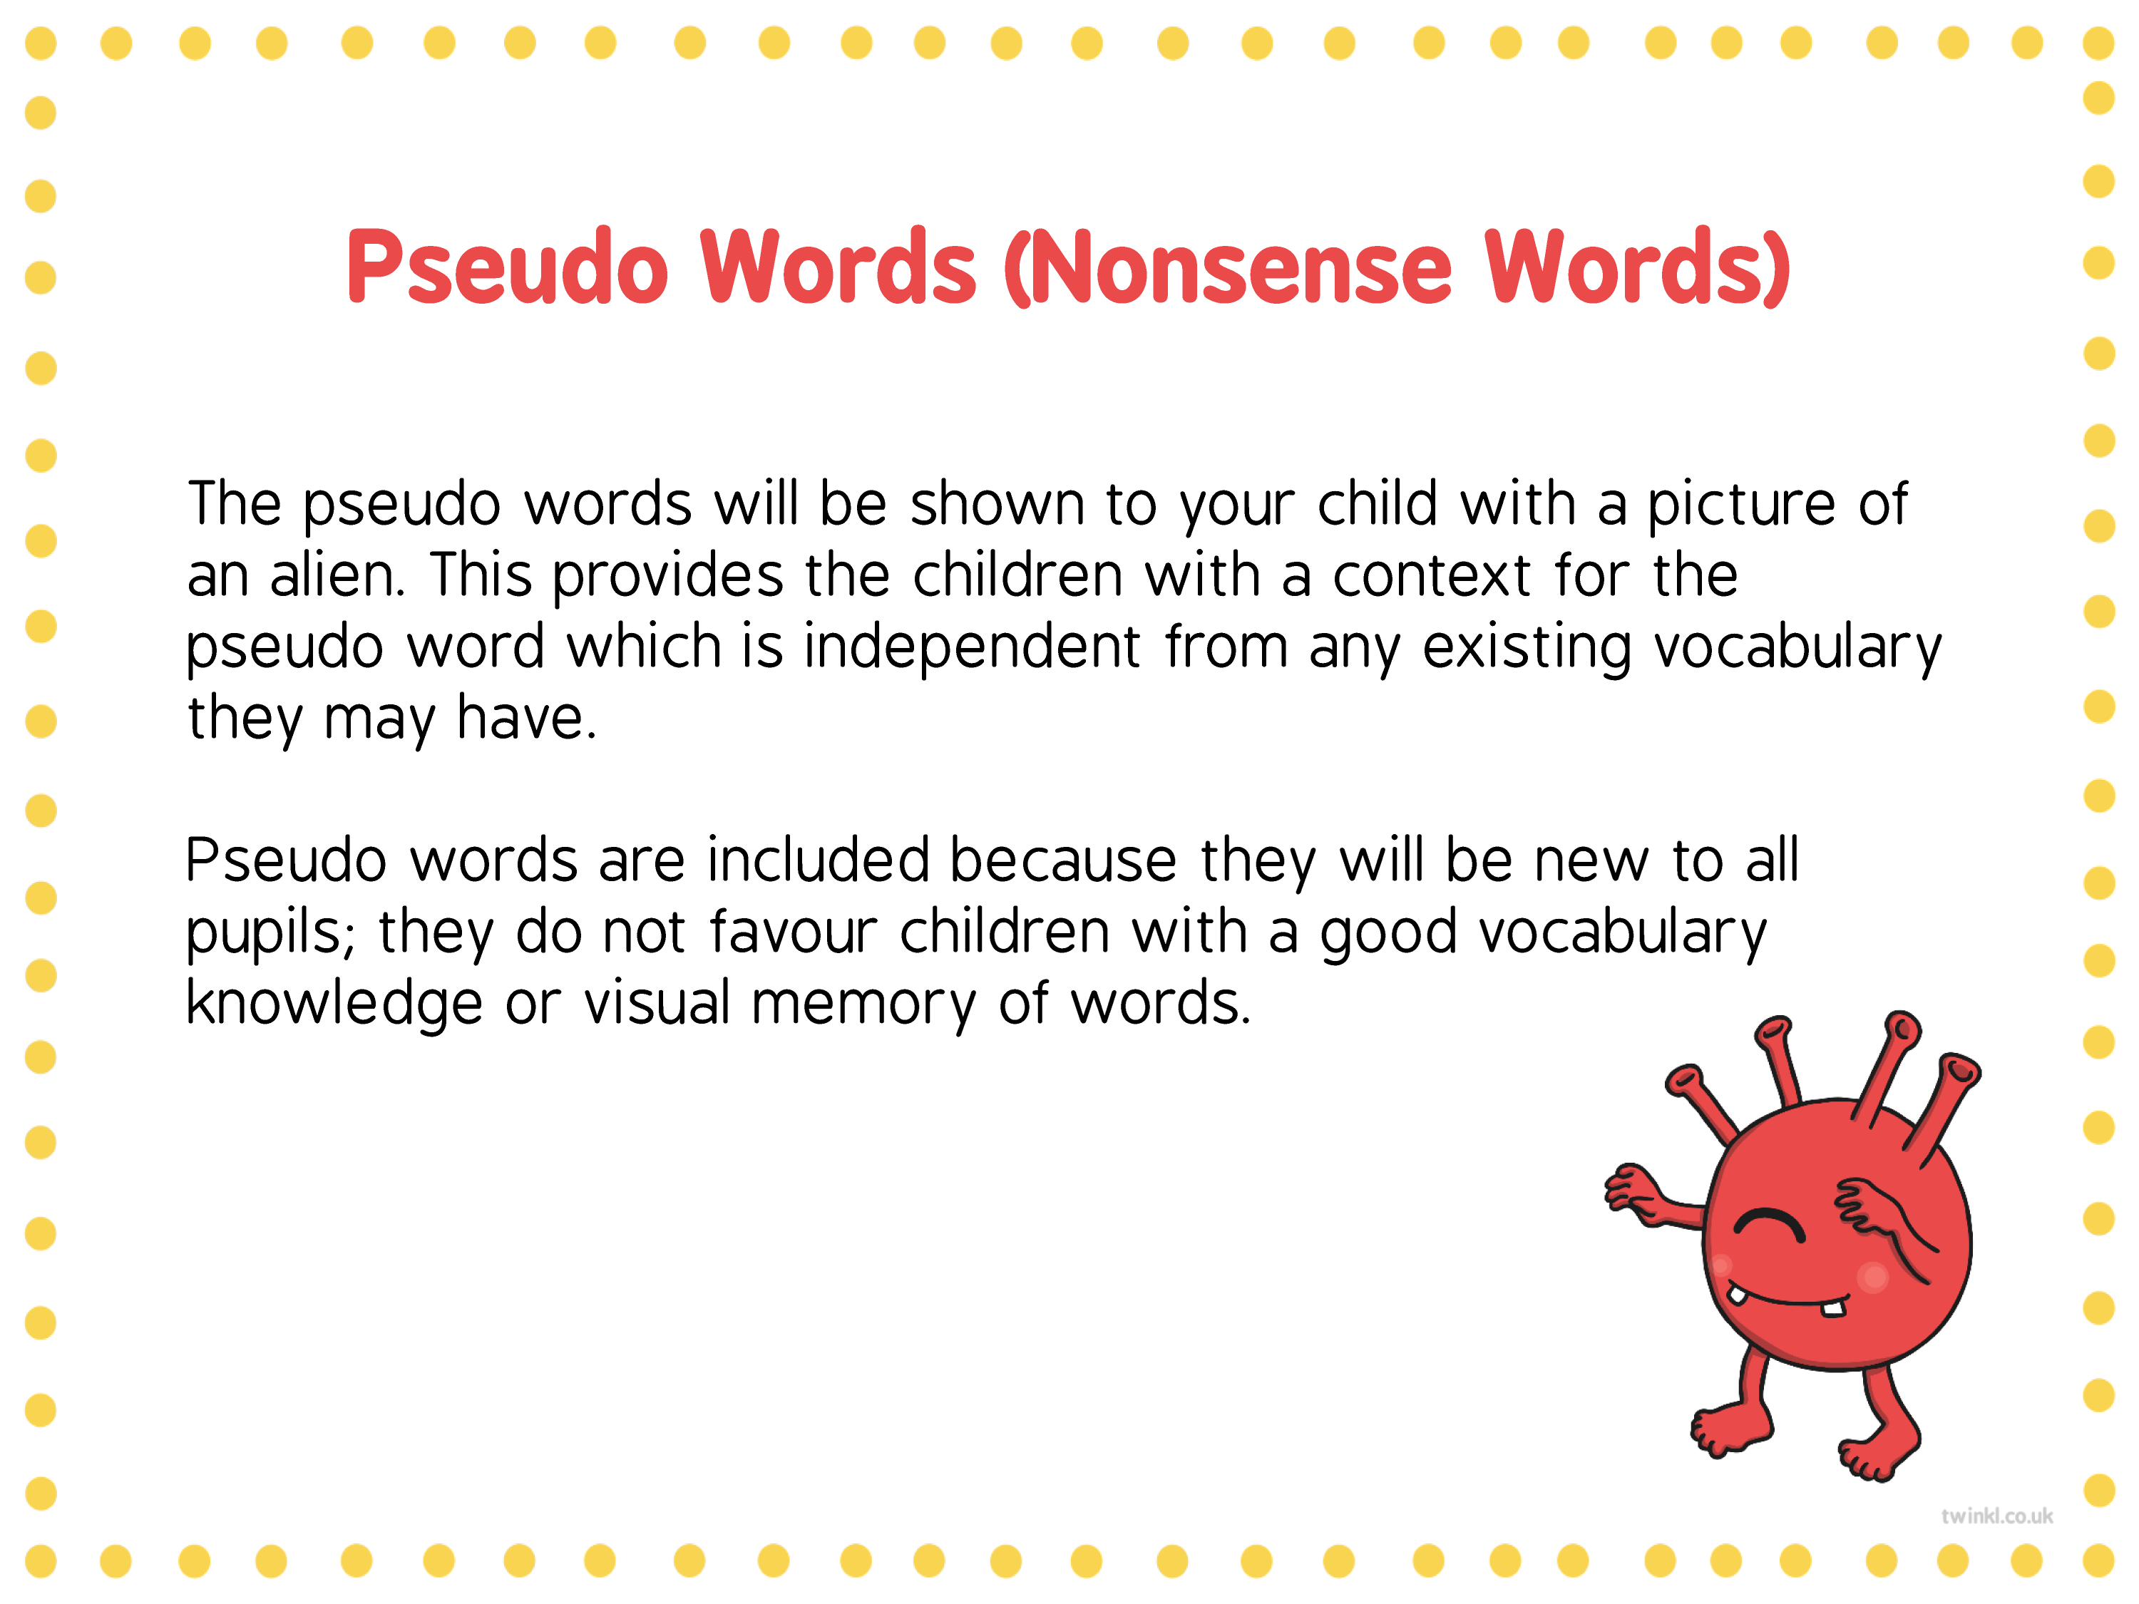

Slide 13
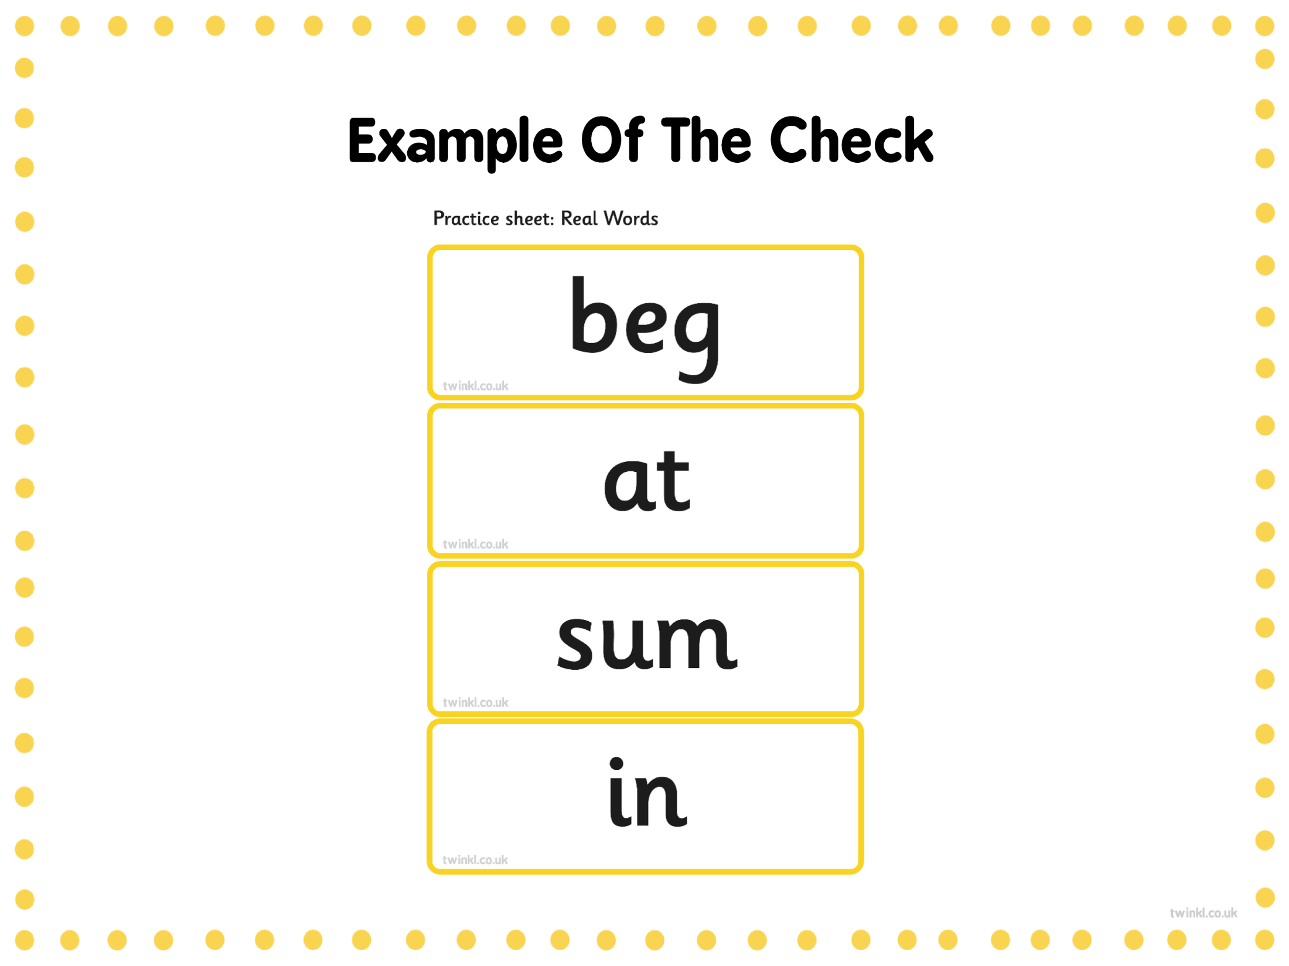
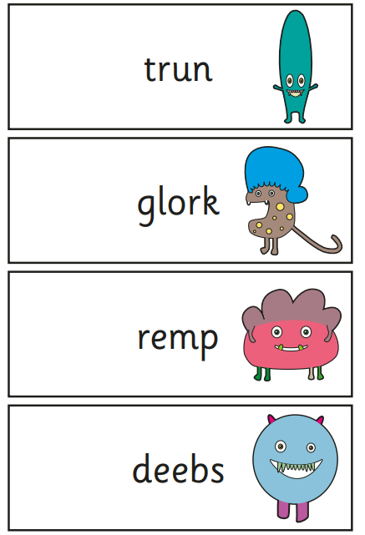
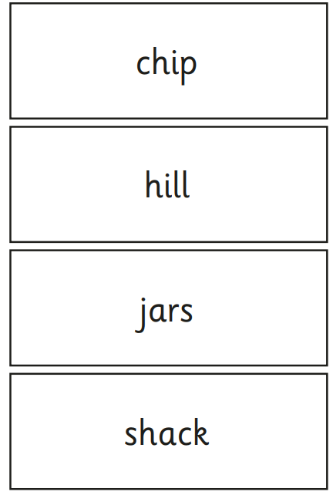

Slide 14
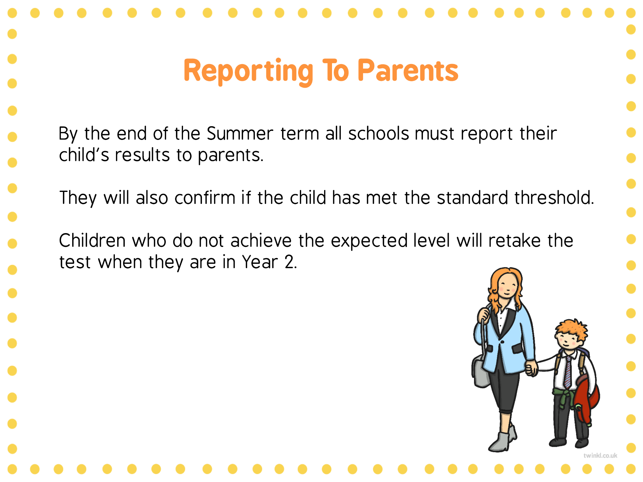
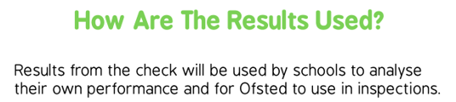

Slide 15
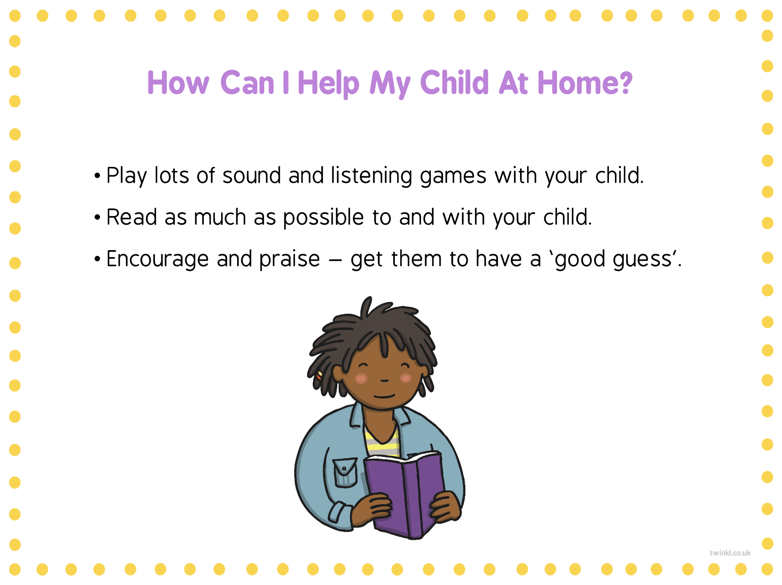
Reading phonetically decodable books at home is very useful for developing children’s phonic skills.
Before your child starts reading, look at the cover and title together. Encourage them to think about what the book might be about to get them engaged and in the right frame of mind to read.
Talk about the book as you read, recapping and asking questions as you go to check your child’s understanding of what they’re reading.
Point to the words as your child reads, encouraging them to try every word to the very end (children learning to read often neglect suffixes).
If they’re struggling with a word, help to break it down into individual sounds, then blend the sounds together. Breaking words down into syllables can also help. With longer or compound words, support children to identify elements of the word they might know or find easier to decode, for instance, rain/ing, kind/est, foot/ball. Cover up part of the word and encourage children to read it in smaller chunks.
If your child is still struggling, it’s OK to tell them the word.
Finally, don’t forget that praise is really motivating for children as they read.

Slide 16

Bug Club – Login at home
Each child has a Bug Club login that is stuck in the front of their reading diaries. It is an early introduction to homework, we put fun, interactive games on there for you to help your child with. Some children need adult support to do this and we want all children to do this weekly as their homework. There is access to more of our reading books on there, if they finish their physical reading books and you’d like to do some more then please do but there is no expectation to do this on top of school reading books.

Slide 17
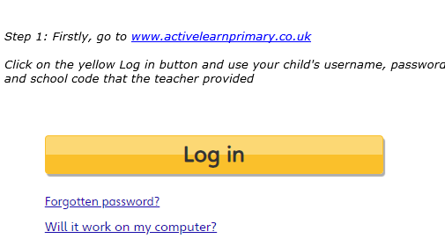
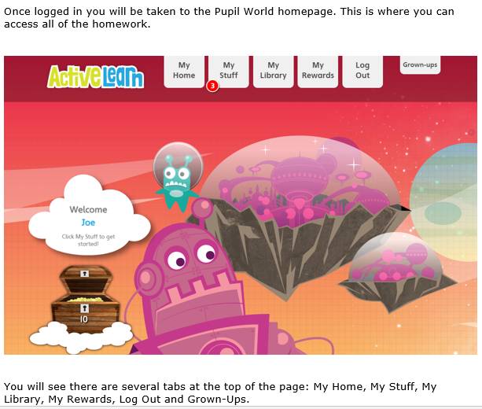
What to do when you log on…
This is available on the Year One webpage...
The handout gives details on how to access any books we set

Slide 18
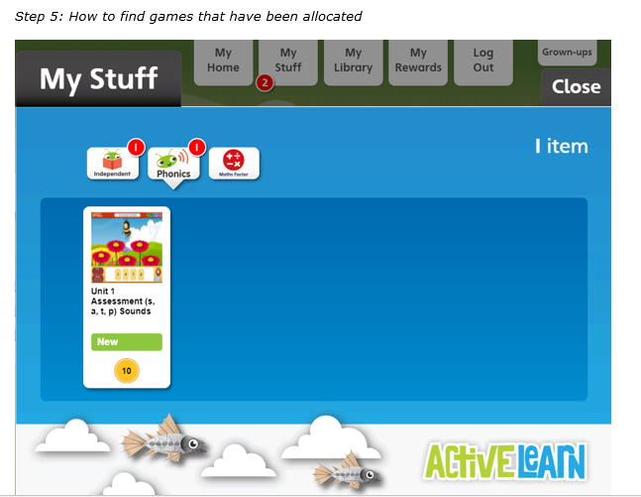
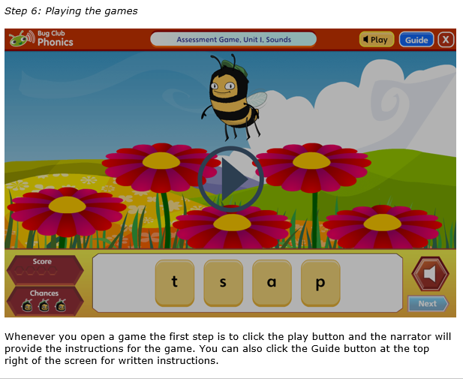



Slide 19


Mock screen and Interventions
Children have completed a mock screen in December, they will complete another one in March, these are carried out to get them used to the process and for us to know where children are at. This has had no time limit and for some children was done in small chunks. There has been pressure, lots of encouragement and time 1 on 1 (which they love).
As a result of the mocks, some children are offered small group interventions Mrs Carr and Miss Fleming. We will let you know if this is your child. It is nothing to be concerned about, it’s a boost for a short time to support and help their learning.

Slide 20
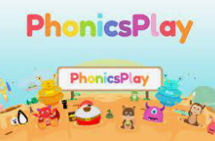

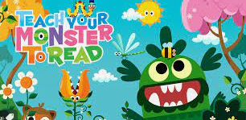
Useful Phonics links & websites
Phonics Play- http://www.phonicsplay.co.uk/
https://www.teachyourmonster.org/
https://mediaplayer.pearsoncmg.com/assets/bcpafsp2
https://mediaplayer.pearsoncmg.com/assets/bcpafsp3
https://mediaplayer.pearsoncmg.com/assets/bcpafsp5a
You Tube-
Mr Thorne does phonics
☺ Thank you for coming ☺
ANY QUESTIONS?

