Slide 1

Welcome to Year One
To be the best that we can be

Slide 2
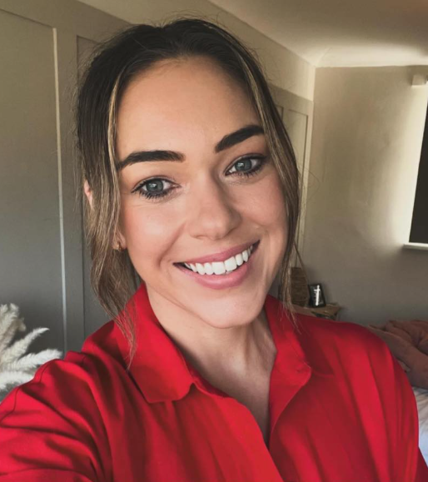
Meet your teachers!
About me
This is my forth year at Thomas Jolyffe in year 1.
I have previously taught in many other schools during the least 20 years in Australia, London and Birmingham
I’m Australian but have lived in the UK for almost 18 years now
. I am a single parent with 2 children. Willow is in year 4 and Max is in year 2.
I work Monday-Thursdays
My Other Roles within school:
- Key Stage One Phase Lead. Phonics & Early Reading Lead
Hello! I’m Mrs Carr
Contact Information
Carr.s@welearn365.com
01789 267015
Class Dojo – We will view messages between 8.30am and 5pm. Please avoid messaging in the evenings and weekends.

Slide 3
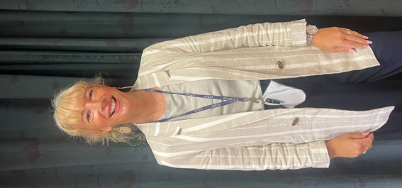
Meet your teachers!
About me
My Roles within school:
I have been teaching at Thomas Jolyffe for 12 years.
I have taught in a range of year groups including Reception, Year 1, 2,3,4,5 and Year 6.
This will be my 2nd year teaching on a Friday in Year 1.
My Roles within school:
School Council
P.P.A. Teacher
Hello! I'm Mrs. Moore
Contact Information
01789 267015
Class Dojo
MOORE.C4@welearn365.com

Slide 4
The Rest of the Year 1 team
Miss parry
Miss Steventon
Miss Fleming
Miss Morris
We work as a team, children are grouped across the year for phonics and reading and will work with a variety of year 1 adults

Slide 5
School Values
To be the best that we can be
Respect
Empathy
Responsibility
Teamwork
Resilience
Kindness and Caring

Slide 6
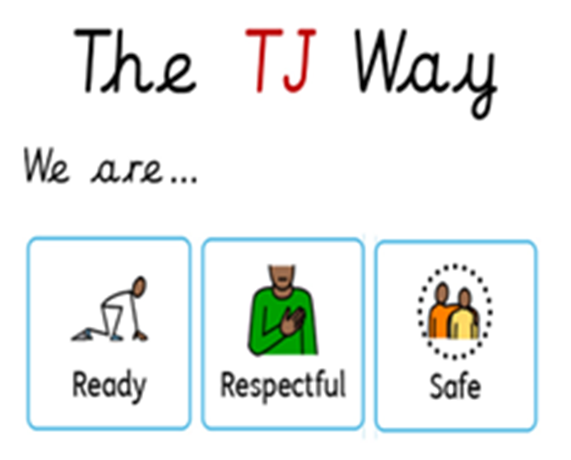
School Values
To be the best that we can be

Slide 7
Expectations for all
Arriving to school on time
Correct school uniform
Correct P.E. Kit
Long hair tied up
Limited jewellery- watch and 1 pair of earrings

Slide 8
What children need every day
Water bottle
Book bags
Reading book and diary
Appropriate shoes and clothing (coats, hats, sunhats etc)
Labelled clothing

Slide 9
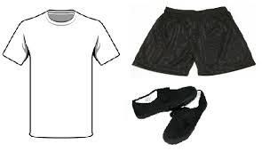
PE Kits Wednesdays and Thursdays
Black joggers/leggings
White t-shirt
Red school sweat shirt or plain black hoodie
Trainers

Slide 10
Communication with staff
Staff member on the gate before and after school for quick messages.
Class Dojo/emails/call school office for more important, serious matters (considering timing of messages and emails).
Any questions or concerns please speak to us

Slide 11
Illness and sickness
Please contact the school office only for attendance
Please keep children off for the full 48 hours with sickness bugs
We can give medication with a prescription

Slide 12
A typical day in Year 1
Morning
Early Morning Task
Phonics
Maths or English
COOL Time
Fruit and snack (inside)
Handwriting
COOL time
Mastering number
Lunch
Afternoon
Guided Reading
Foundation subjects
(History/Geography/RE/PSHE/Music/Art/DT/Computing/PE)
COOL time
Afternoon break
Story
Home time
Half of the children
Are working in a group with adults, Half in COOL time and then we swap.

Slide 13
A typical day in Year 1
Extras
Assembly
Outdoor Learning
Well-being lesson
No Outsiders (half termly)
School trips
Special visitors
Celebrations
Rewards

Slide 14
What is COOL time?
Chose our own Learning. Often referred to as Continuous Provision or Enhanced Continuous provision.
Play based style of learning with open ended resources .Children move around the classroom and chose where they want to spend their time. Each area has carefully selected resources and activities set up for the children to explore. Some are more play based, like the construction, small world and roleplay areas. Some have activities directly linked to what we are learning about in class.

Slide 15
Homework
Reading at least 3 times a week and signed in reading records
Phonics Bug Club games and books. More details to follow in the coming weeks.
Counting in 2s, 5s and 10s and telling the time at o’clock.

Slide 16

Reading
Reading in year 1 will be slightly different to Reception and to previous years
Children will take home 2 books from the same set (the same level). One of these books the will have read in class with an adult twice already and one book will be new to them. Please try and read BOTH books with your child during the week and fill out their reading diaries so we know the books have been read. If they haven’t been able to read both of the book, the unread book may be sent home for another week.
Younger children need to read the same text several times in order to become fluent and work on comprehension (the first time/s is usually spent decoding).
.

Slide 17
Key Dates/ Upcoming Events
December – Christmas singalong date TBC
December – trip to Warwick Arts centre date TBC
June – Phonics Screening Check
Workshops TBC

Slide 18
Thank you!
Do you have any questions?
admin2052@welearn365.com
Carr.s@welearn365.com

