Slide 1
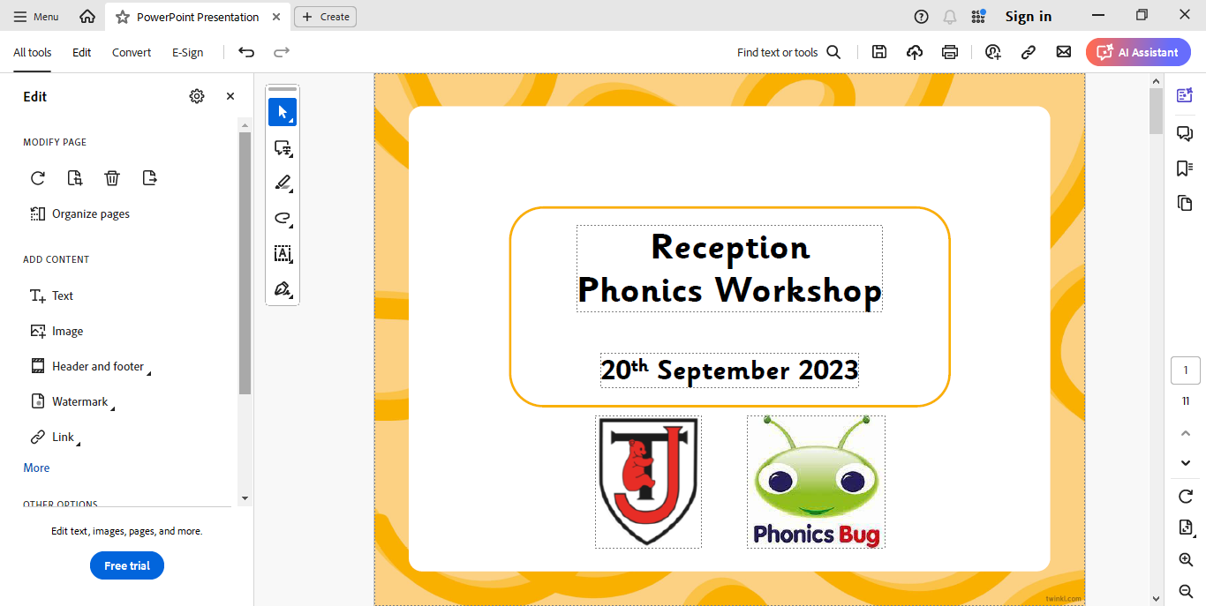
Reception Phonics
Workshop
Wednesday 10th September 2025

Slide 2
Introducing Phonics
Phase One
Phase Two
Phase Three
Phase Four
Phase Five
Phase Six

Slide 3

Did You Know…?
The English language has:
over 100 ways to spell those sounds
26 letters
44 sounds
x
u
a
e

Slide 4
Phonics Terminology
systematic synthetic phonics - The teaching of reading and spelling by breaking down words into the smallest unit of sound.
phoneme - Any one of the 44 sounds which make up words in the English language.
grapheme – How a phoneme is written down. There can be more than one way to spell a phoneme. For example, the phoneme ‘ai’ is spelt differently in each of the words ‘way’, ‘make’, ‘fail’, ‘great’, ‘sleigh’ and ‘lady’.
blending – Putting together the sounds in a word in order to read it, e.g. ‘f – r – o – g, frog’.
segmenting – Breaking a word into its constituent sounds in order to spell them, e.g. ‘frog, f – r – o – g’.

Slide 5


What Is Phonics?
reading and spelling
hearing, recognising and using sounds
routine and familiarity
focus on breaking down and building up words (segmenting and blending)
tricky/common exception words

Slide 6


Our Phonics Scheme
https://www.activelearnprimary.co.uk/planning#bugclub_phonics

Slide 7
Teaching Phonics
Revisit & Review
Children are taught Phonics daily.
Each session will follow a structured format..
Teach
Reception children are required to be secure at Phase 4 Phonics by the end of the year. Therefore progress is carefully monitored to ensure children are working at the correct level.
Practise
Apply

Slide 8





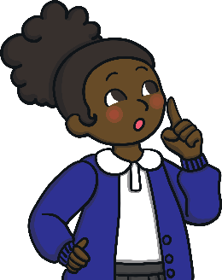

Phase One
Phase 1 has seven aspects, with a focus on listening skills.
Environmental sounds
Instrumental sounds
Body percussion
Rhythm and rhyme
Alliteration
Voice sounds
Oral blending and segmenting

Slide 9
Phase Two

Slide 10

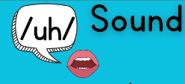

Pronunciation, segmenting and blending
https://www.thomasjolyffe.warwickshire.sch.uk/phonics-7/

Slide 11
Tricky Words
Common exception words (tricky words) can’t be decoded using normal phonic rules. Children just have to learn them!
Some examples are, ‘I’, ‘to’ and ‘the’
Each phase has a new set of tricky words.

Slide 12
Support for you
Reception website – Phonics page
Weekly parent’s planning with sounds and tricky words to learn
Teach Your Monster to read app
Reading diary – to record reading at home to help us track progress.

Slide 13

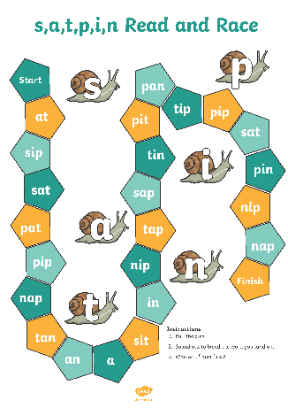
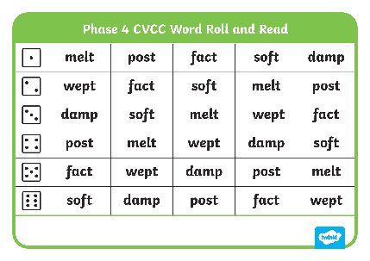


Helping Your Child at Home
provide opportunities for mark making and writing
use ideas we have provided, make it fun!
      provide opportunities for reading

Slide 14

Thank you for you time
We hope it has been useful!

