Slide 1

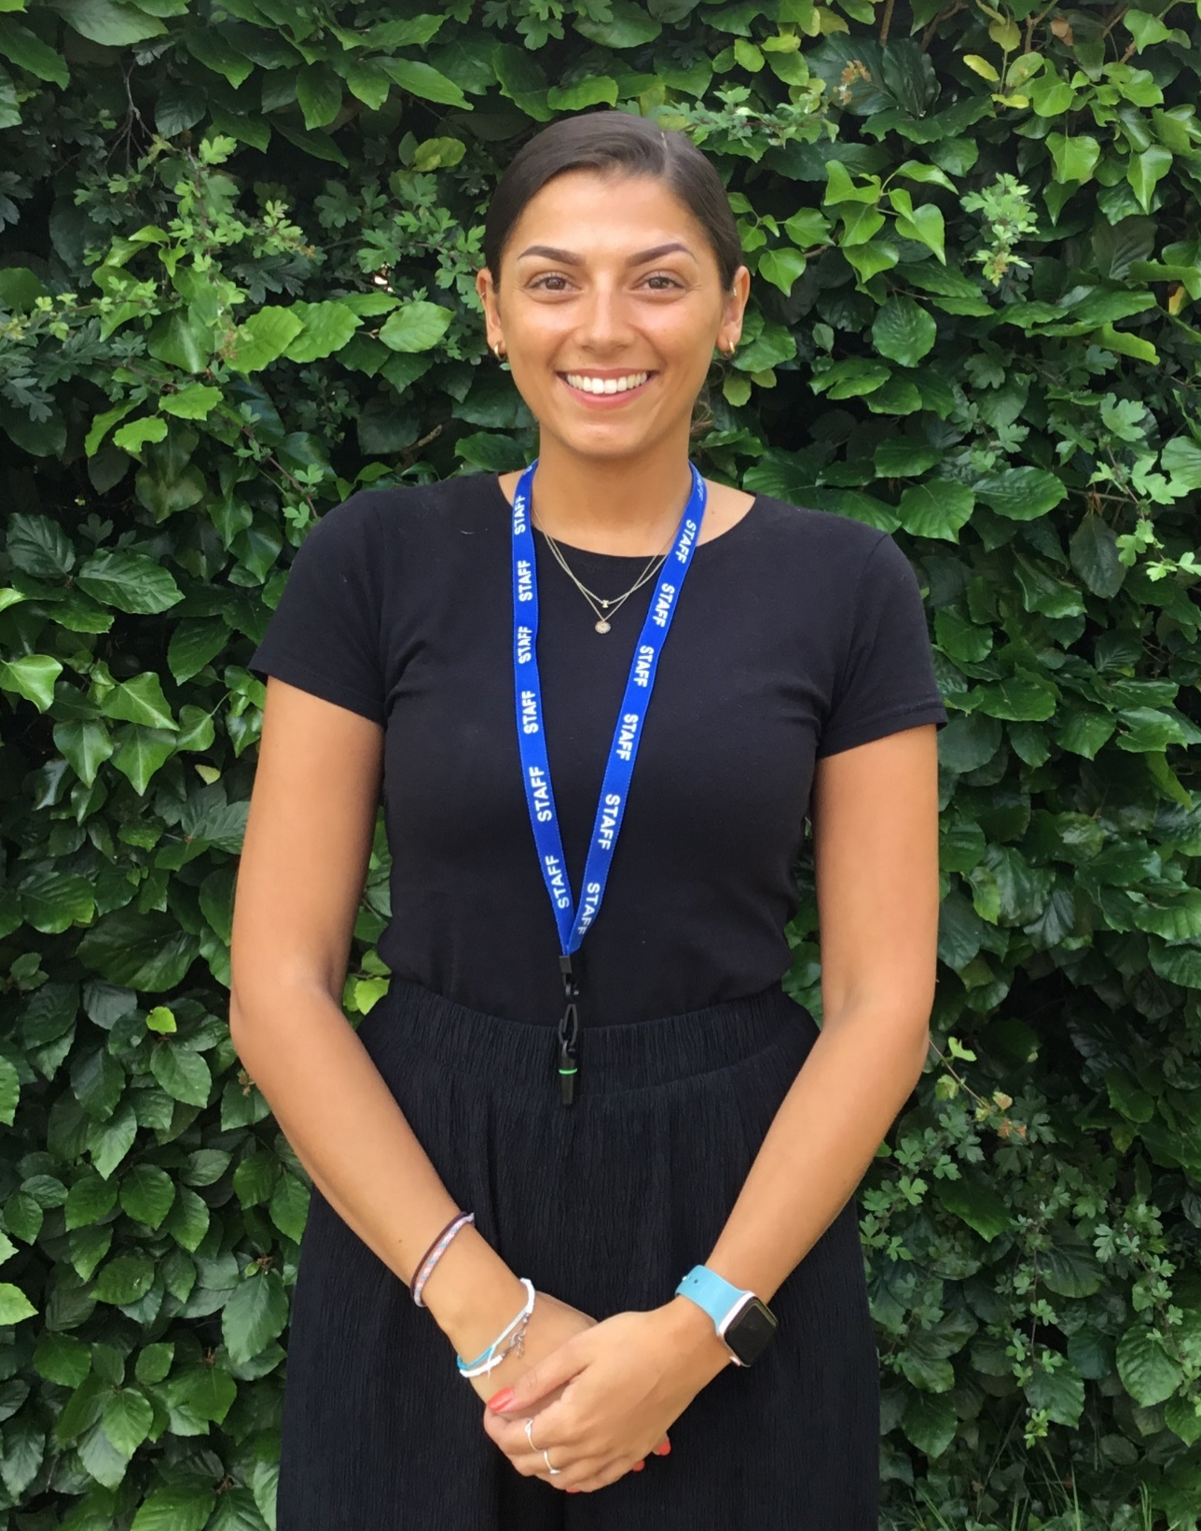
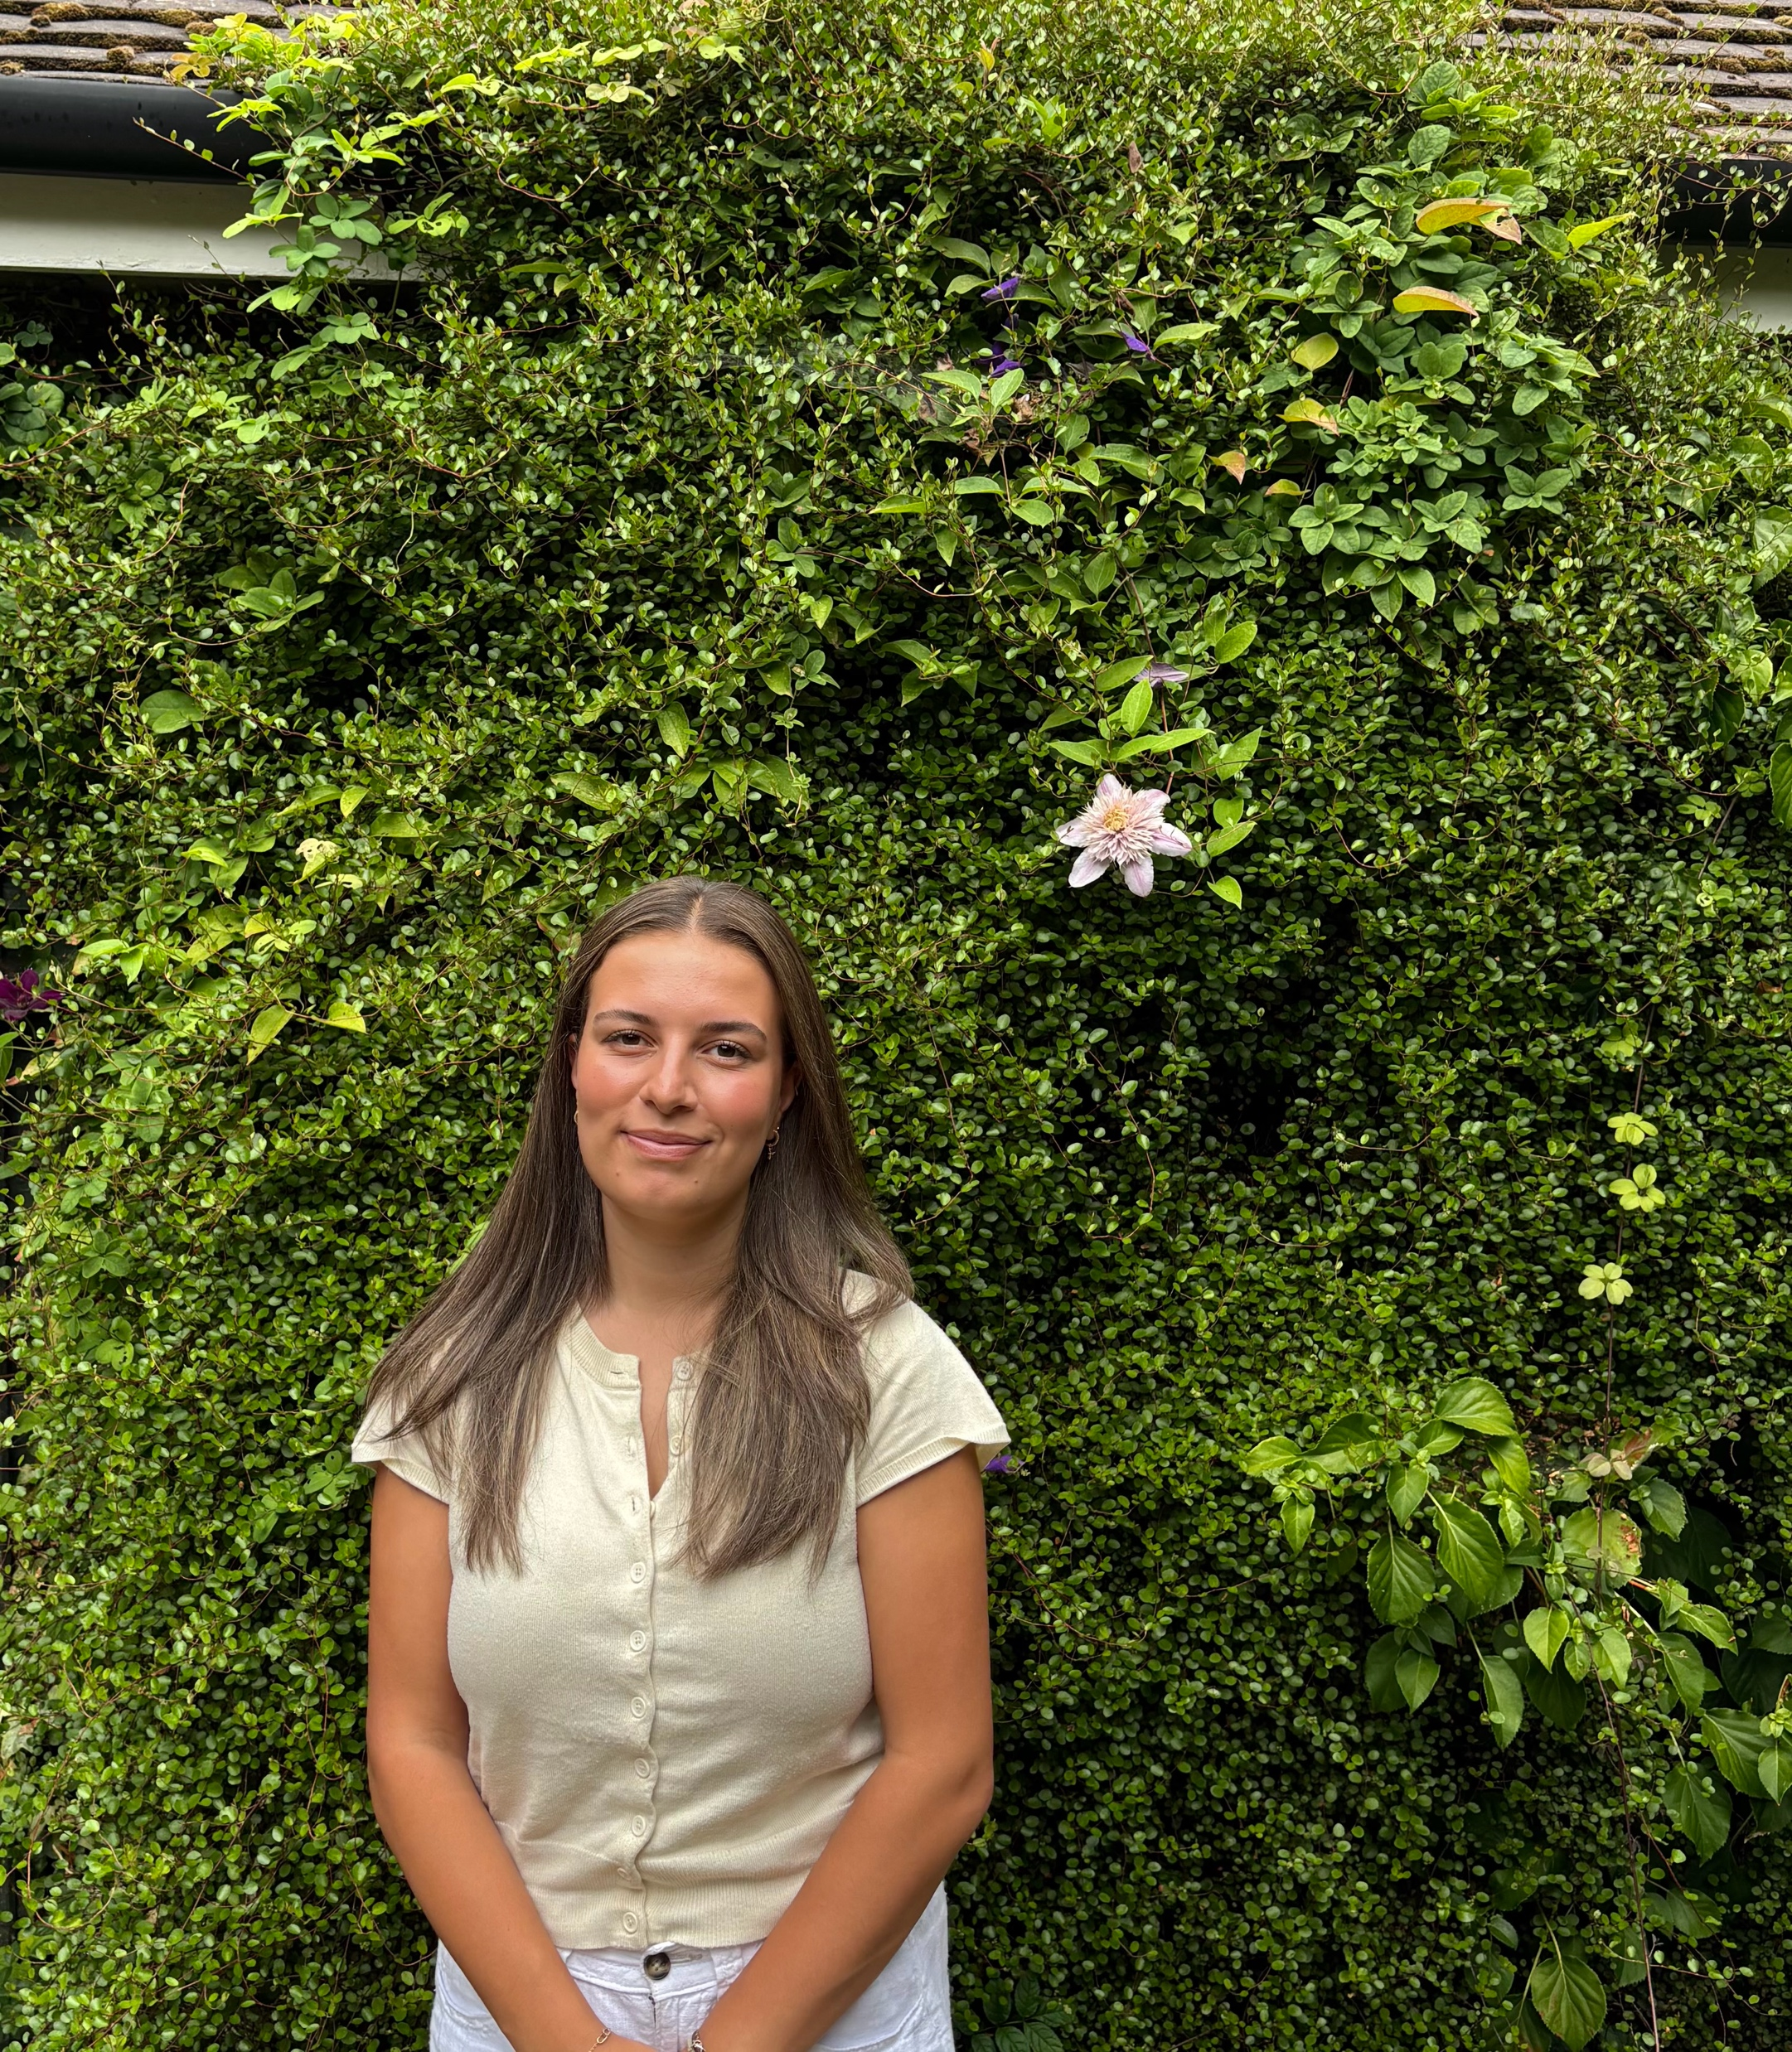
Reception Staff, 2025-2026 Class RK (Reception Kashani)
Early Years Foundation Stage Lead Hello, I am Miss Kashani I am the Reception teacher in class RK and my passion is in Early Years. I feel this is the most important time to capture a child’s interest and imagination in order to create a happy positive learning environment that will last a lifetime. I have been teaching Reception at Thomas Jolyffe for eight years now and love working here. I am a qualified Forest School Leader, which gives children the opportunity to learn new skills in an outdoor environment. In my spare time, I enjoy walking the family dogs Max, Maggie, Bella and Nero. I also love to travel, listen to music, keep fit and socialise with my friends and family. I love going to the beach ~ my mum lives at the seaside, so I always enjoy visiting! My favourite colour is pink and my favourite film is Matilda.
Hello, my name is Miss Wallbank and I will be the teaching assistant in class RK. I have recently graduated from University with a degree in Psychology and have been working at Thomas Jolyffe since November. I have loved being able to gain an insight into early childhood development and see each child flourish and grow in a positive and supportive environment. In my free time I love taking my little dog Archie out for long walks with my family and spending lots of time with my friends. I also love to travel and experience lots of new places and cultures around the world! My favourite colour is blue, and my all-time favourite film is Paddington- as he’s always ready for a new adventure. My family and I watch it every Christmas Eve! I’m really looking forward to the year to come and meeting all of you.

