Slide 1

Welcome to Year ….
To be the best that we can be

Slide 2
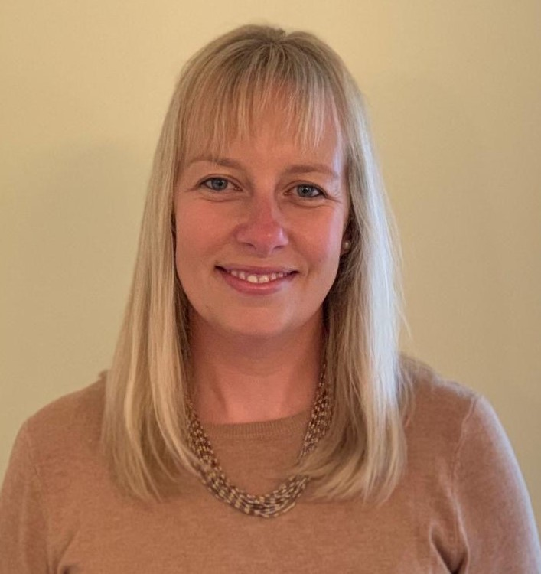
Meet your teacher!
About me
I have been teaching at Thomas Jolyffe for 19 years.
I have taught in a range of year groups including Reception, Year 1, 3, 4 and Year 6.
This will be my 4th year teaching in Year 6.
My Roles within school:
Deputy Head
DDSL
PSHE Lead
Foundation Curriculum Lead
EVC Co-Ordinator
ECT Lead Mentor
Hello! I'm Mrs. Preedy
Contact Information
preedy.r@welearn365.com
01789 267015
Class Dojo

Slide 3
Meet your teacher!
About me
I have been teaching for 9 years. This is my first year teaching at Thomas Jolyffe.
I have taught in a range of year groups including Year 6, Year 3 and Nursery.
This will be my 3rd year teaching in Year 6.
I teach Year 6 on a Wednesday, Thursday and Friday but am in school all week.
My Roles within school:
- Computing lead
Hello! I'm Ms Arnold
Contact Information
arnold.a@welearn365.com
01789 267015
Class Dojo

Slide 4
School Values
To be the best that we can be
Respect
Empathy
Responsibility
Teamwork
Resilience
Kindness and Caring

Slide 5
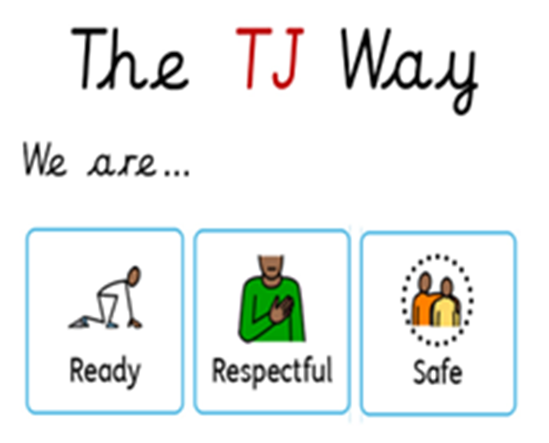
School Values
To be the best that we can be

Slide 6
Expectations for all
Punctuality
Communication
Correct school uniform
Long hair tied up
P.E. Kit
Limited jewellery- watch and 1 pair of earrings
No mobile phones
Daily equipment
e.g. water bottle

Slide 7
A typical day in Year 6
Wider Curriculum
Geography
History
Science
Art and D.T
P.S.H.E- Protective behaviours, jigsaw, ZOR, No outsiders
French
R.E
P.E
Music
Daily
Early Morning Work
English
Maths
Teaching of Reading
Free time reading
Theme
Class reading Time
Extras
Assembly
GPS and Spelling lessons
Swimming
Outdoor Learning
Well-being lesson
No Outsiders (half termly)

Slide 8
Homework
Reading at least 4 times a week and signed in reading records
Weekly spelling activity (spelling shed and written activity) set on a
Tuesday. To be handed in the following Tuesday.
GPS and Math set every Friday. To be handed in the following Friday.
Theme to be set termly. Activites linked to Foundation Curriculum.

Slide 9
Homework Expectations
Homework to be handed in on time.
Children’s work. Support can be given. Please encourage your child to speak to their class teacher if they are finding it difficult.
To be completed to a high standard- cursive handwriting in a blue/black pen or pencil.
Homework completed in homework books (in school weekly).

Slide 10
Key Dates/ Upcoming Events
September- Bellboating
October- SATs meeting
December- Christmas Singalong
Spring- Trip linked to History topic

Slide 11
Thank you!
Do you have any questions?
admin2052@welearn365.com
Preedy.r@welearn365.com
arnold.a@welearn365.com

