Slide 1


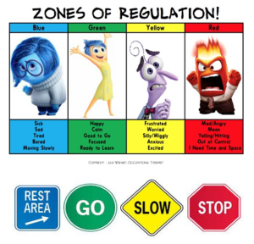

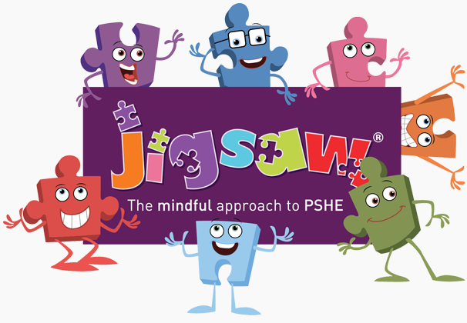
P.S.H.E Curriculum

Slide 2
P.S.H.E at Thomas Jolyffe
At Thomas Jolyffe Primary School our pupils’ personal, social and emotional development is secured by a supportive school ethos.
Positive relationships are valued and encouraged - seen as important to ensure there is a safe and secure school environment conducive to learning.
The children’s wellbeing, happiness and safety are our first priorities.
PSHE is one of the key vehicles through which we share this with the children.
It give the children the knowledge, skills and understanding they need to lead confident, healthy, safe and independent lives enabling them to become informed, active, responsible British citizens.

Slide 3
Our PSHE curriculum enables our children to aspire to our school moto
‘To be the best that we can be’.
We believe that PSHE education is key in developing a child’s
“whole self”
whilst also promoting equality, inclusion and social justice.

Slide 4
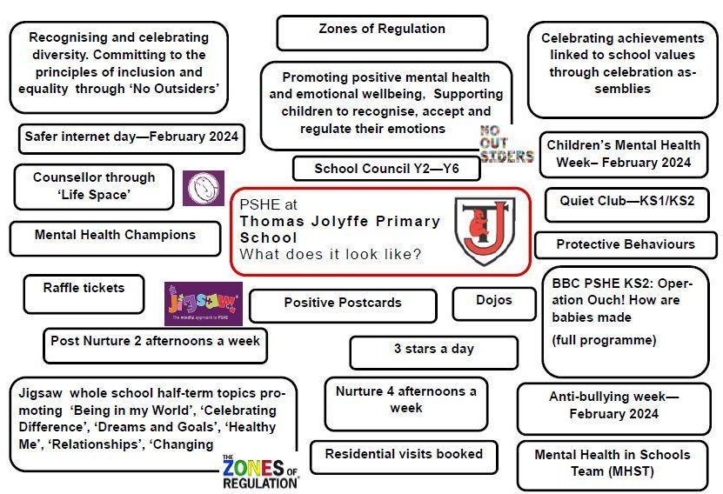

Slide 5
How P.S.H.E is taught throughout all year groups
Jigsaw
No Outsiders
Zones of Regulation
Protective Behaviours

Slide 6

Jigsaw
6 jigsaw pieces
These 5 jigsaw pieces are then broken down further into 6 different lessons.

Slide 7
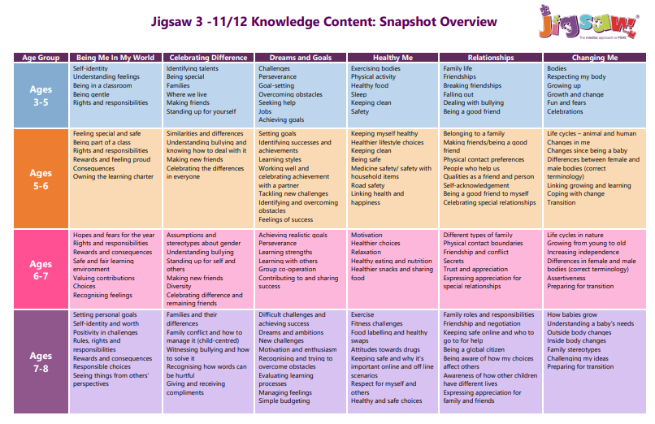
Jigsaw- Overview

Slide 8
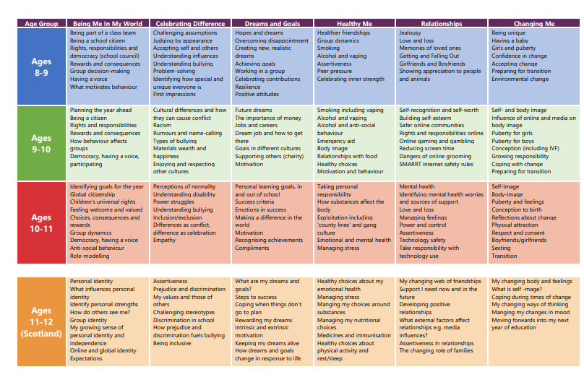

Slide 9
Jigsaw
Lesson Format
The jigsaw Charter
Connect us- variety of games
Calm me
Share learning objective
Time for discussion, group activities, tasks
Reflection
Next steps to learning

Slide 10
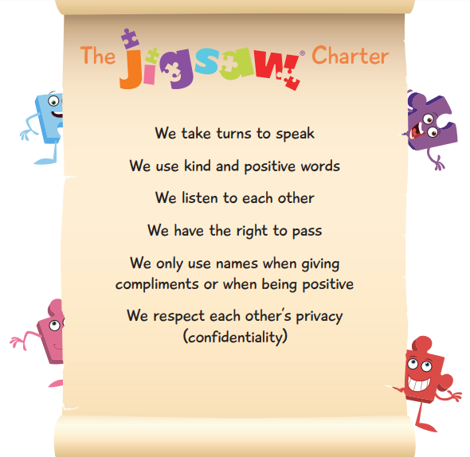

Slide 11
Jigsaw
Curriculum Links
Anti-Bullying week
Internet safety
Road Safety
Sun safety
Water safety
Healthy Teeth and Gums
Themes- firework safety

Slide 12
No Outsiders
The 'No Outsiders' programme educates children about diversity within our communities and addresses issues such as sexism, ageism, race and different types of families. It is taught to each year group through the use of age-appropriate books.
Our Ethos
We are a caring community where values are built on mutual trust and respect for all regardless of race, religion, ethnicity, sexual orientation, gender identity, disability, age or gender.

Slide 13
No Outsiders
How it is taught
Assemblies Examples
I lesson every half term based on a age appropriate book
A time to talk
A time to relate
Notes:
Children so open- matter of fact
Boys dancining- year 6

Slide 14
No Outsiders
Themes
Key Stage 1
Making friends
Family
I like the way I am
To join in
Feeling proud
Diversity
Playing together
Self confidence
Sharing
Key Stage 2
Immigration
Racism
Freedom of speech
Democracy
Acceptance
Consequences
Stereotype
Belong
Feeling welcome

Slide 15
No Outsiders
Key Messages
Diversity
We all belong
Everyone is welcome

Slide 16
Zones of Regulation
We recognise the importance of promoting positive mental health and emotional wellbeing with our children, families and within our wider community.
Our vision is to create an open culture around the discussion of mental health and wellbeing and to empower our children to be able recognise, accept and regulate their emotions.
By implementing the ‘Zones of Regulation Curriculum’, we strive to teach our children and give them the ability to identify emotions in themselves and others, whilst developing a bank of strategies to help them regulate their emotions, improving their wellbeing.

Slide 17
Zones of Regulation
What is it? How is it implemented?
ZOR is an internationally renowned curriculum that supports and teaches children to manage difficult emotions, known as ‘self-regulation’.
Self-regulation- ‘self-control’, ‘impulse management’ and ‘self-management’.
Self-regulation is best described as the best state of alertness for a situation.
From time to time, all of us (including adults) find it hard to manage strong feelings such as worry, anger, restlessness, fear or tiredness, and this stops us from getting on with our day effectively.
Children who feel these emotions often find it hard to learn and concentrate in school.
ZOR aims to teach children strategies to help them cope with these feelings so they can get back to feeling calm and ready to learn. These coping strategies are called ‘self-regulation'.
Notes:
For example, when your child takes part in a sports game or activity they would need to have a higher state of alertness than when, for example, they are reading or completing work.

Slide 18
Zones of Regulation
We aim to help children to:
• Recognise their different zones and learn how to change or stay in the zone they are in.
• Increase their emotional vocabulary to better explain how they are feeling.
• Recognise when other people are in different zones, developing empathy.
• Recognise personal triggers, developing an understanding of what might make them move into the different zones.
• Understand that emotions and sensory experiences such as lack of sleep, hunger and their environment might influence which zone they are in.
• Develop problem-solving skills and resilience
• Identify a range of calming and alerting strategies that support them
(known as their personal ‘toolkit’).
Notes:
For example, when your child takes part in a sports game or activity they would need to have a higher state of alertness than when, for example, they are reading or completing work.

Slide 19
Zones of Regulation
We aim to help children to:
• Recognise their different zones and learn how to change or stay in the zone they are in.
• Increase their emotional vocabulary to better explain how they are feeling.
• Recognise when other people are in different zones, developing empathy.
• Recognise personal triggers, developing an understanding of what might make them move into the different zones.
• Understand that emotions and sensory experiences such as lack of sleep, hunger and their environment might influence which zone they are in.
• Develop problem-solving skills and resilience
• Identify a range of calming and alerting strategies that support them
(known as their personal ‘toolkit’).
Notes:
For example, when your child takes part in a sports game or activity they would need to have a higher state of alertness than when, for example, they are reading or completing work.

Slide 20
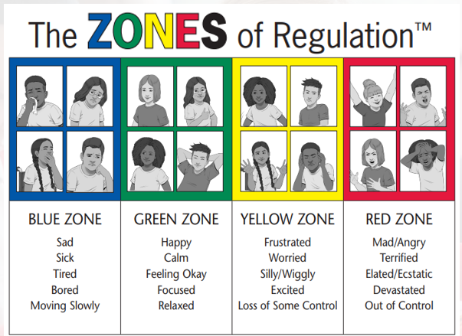
Zones of Regulation
What are the different Zones?
Blue Zone: low level of arousal; not ready to learn; feels sad, sick, tired, bored, moving slowly.
Green Zone: calm state of alertness; optimal level to learn; feels happy, calm, feeling okay, focused.
Yellow Zone: heightened state of alertness; elevated emotions; has some control; feels frustrated, worried, silly/wiggly, excited, loss of some control.
Red Zone: heightened state of alertness and intense emotions; not an optimal level for learning; out of control; feels mad/angry, terrified, yelling/hitting, elated, out of control.

Slide 21
Zones of Regulation
We can all relate to ZOR
Children refer to emotions on a daily basis- lollipop sticks
This can also be used at home- ideas on our school website
Also links to children’s films- Inside Out
Inside Out- Bing Bong is confronted by sadness

Slide 22
Protective Behaviours
Protective Behaviours (PB) is a practical, empowering approach to personal safety.
It is a process that encourages and develops self-confidence alongside skills that help us avoid being victimised.
This is achieved by recognising our personal concept of safety, trusting our intuitive feelings (early warning signs) that tell us when we are feeling unsafe and developing strategies for self-protection.
The Protective Behaviours process links safety with fun and excitement and an adventurous approach to life.
Protective Behaviours

Slide 23
Protective Behaviours
Early Warning Signs
What are they?
When do we get them?

Slide 24
Early Warning Signs
Pounding Heart
Goose Bumps
Dry Mouth
Tight Lump
Blurred Vision
Can’t See
Wide Eyes
Need a Wee
Frozen Limbs
Fluttering Tum
Sweaty Palms
Squelchy Bum
Jelly Legs
Can’t Move
Feel Sick
Where’s the Loo
Muddled Thoughts
Hair on End
Fight or Flight?
I Need a Friend
This poem was written with an eight year old boy who was not feeling safe at school. When his teacher heard his words through his poem, she started to listen more and offered him the understanding he needed.

Slide 25
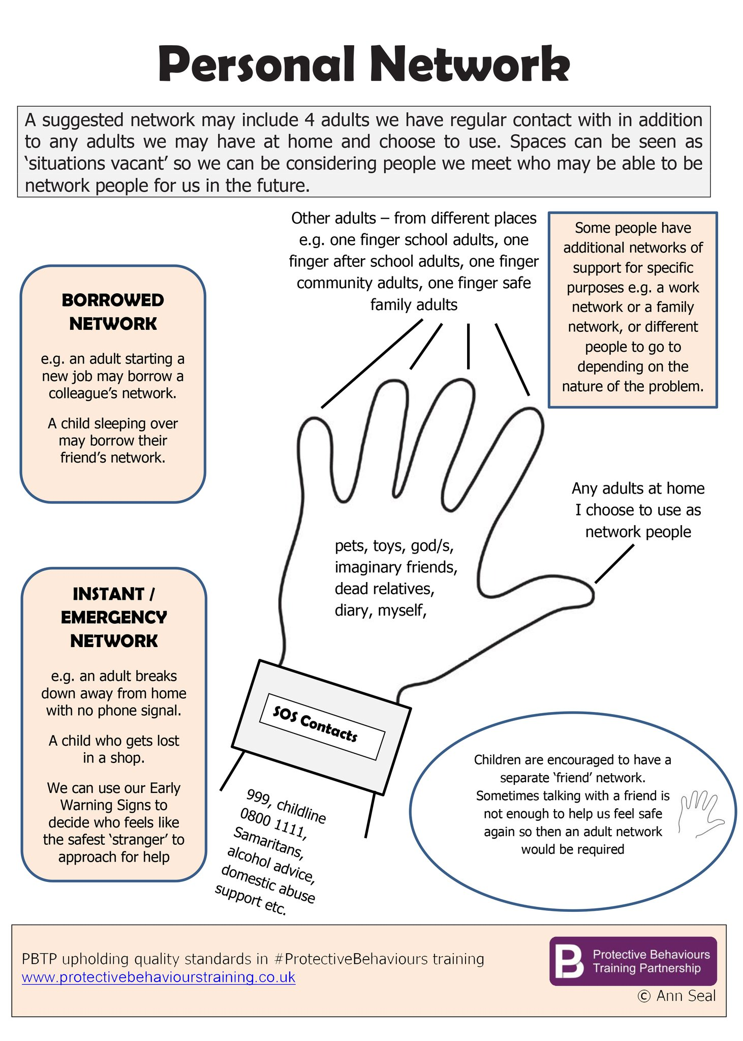
Protective Behaviours
Network Hands
Completed at the end of every half term
…..

Slide 26
The No Outsiders books are interesting and make you understand better.
We look after our well-being. We listen to each other take turns to speak.
We have lots of fun.
I am listened to.
I like our lessons as we have time to listen to each other.
We get to learn with our jigsaw pieces and hug them.
I like learning about how we feel.
P.S.H.E Curriculum
The Voice of our Pupils
We learn how to follow rules and why they are important.
We learn about different views
and our likes and dislikes.
It is a really calm time of the week.
I like that we can be completely truthful when doing P.S.H.E.
We each have a voice.

Slide 27
P.S.H.E Curriculum
Further information can be found on our school website or contact me directly.

Slide 28
P.S.H.E Curriculum
Thank you for attending

